Slide 1
Prevalence Modelling
DECISION RESOURCES GROUP | SEE THE OPPORTUNITIES
Omnya El Massad
Ru Yun Chiang
Published: October 2018
Notes:
NOTE: There are additional master layout styles in this template. Go to the layout button on the home tab to find more.

Slide 2
agenda
WHAT IS PREVALENCE VS INCIDENCE?
WHY DO WE CARE? WHAT ARE THE USE CASES?
HOW TO EXTRAPOLATE NATIONAL PREVALENCE FROM RWD?
DATA CHALLENGES
BUSINESS RULES TO OVERCOME CHALLENGES
CASE STUDY WALKTHROUGH
EXERCISE TIME!

Slide 3
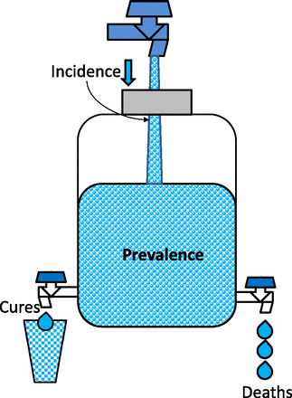
WHAT IS PREVALENCE VS INCIDENCE?
Incidence vs Prevalence
Prevalence, sometimes referred to as prevalence rate, is the proportion of persons in a population who have a particular disease or attribute (new and pre-existing) at a specified point in time or over a specified period of time.
Incidence refers to the occurrence of new cases of disease or injury in a population over a specified period of time.
Source: Centers for Disease Control and Prevention (https://www.cdc.gov/ophss/csels/dsepd/ss1978/lesson3/section2.html)
Source: Epidemiology and Clinical Research Design, Part 2: Principles. V Manja & S Lakshminrusimha. NeoReviews Feb 2015, 16 (2) e94-e108; DOI: 10.1542/neo.16-2-e94

Slide 4
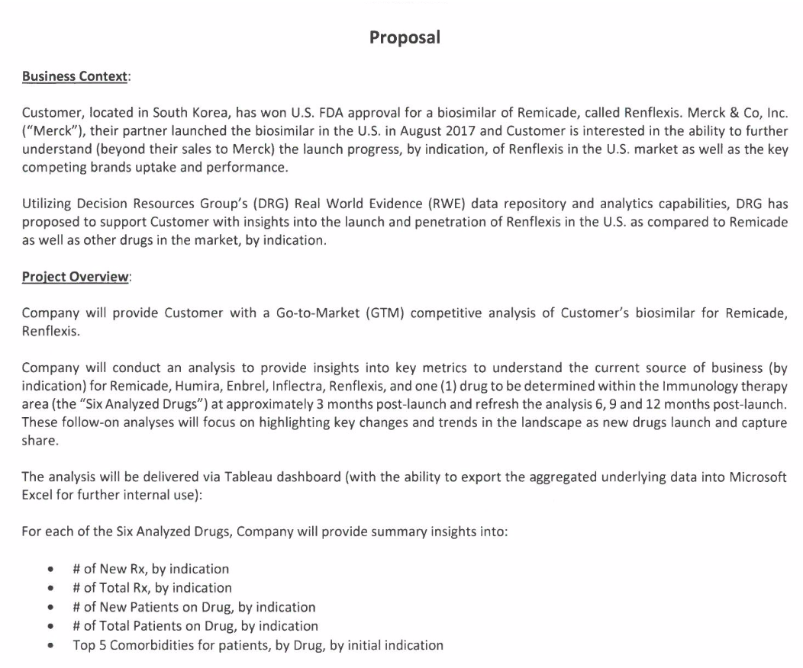
Market Sizing: Estimate the number of target patients. Determine your penetration rate.
Use Case 1: Samsung Immunology Market Tracking
WHY DO WE CARE? What are the use cases?

Slide 5
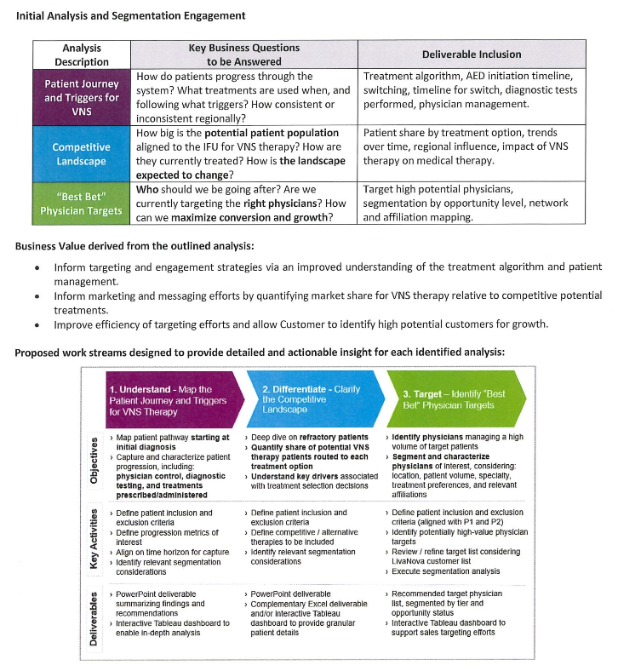
Use Case 2: LivaNova Vagus Nerve Stimulation (VNS) Therapy Study
Physician Targeting: New drug launch. Target high potential physicians.
WHY DO WE CARE? What are the use cases?

Slide 6
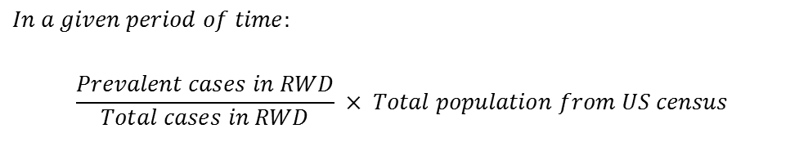
HOW TO extrapolate NATIONAL PREVALENCE FROM RWD?
2
Conceptually…
$$In a given period of time:$$
$$\frac{Prevalent cases in RWD}{Total cases in RWD} × Total population from US census$$
1
3
Notes:
Add incidence
Type of projects/ use cases/business questions

Slide 7

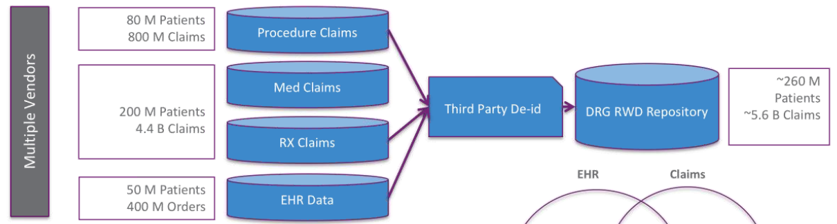
DATA CHALLENGES - 1
Time lag – There’s a time lag between when the claims were submitted and when we received them
How DRG Real World Data is Collected
Time lag → 60 - 90 Days
Notes:
Need Omnya’s input here

Slide 8
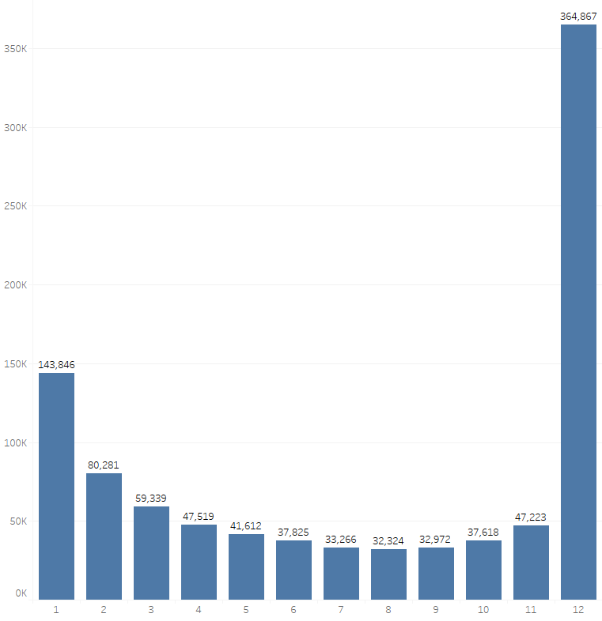
DATA CHALLENGES - 2
Continuous coverage challenge – Inconsistent data coverage from facility to facility is seen in RWD. The graph to the right shows that not all facilities has data coverage across all 12 months in 2017.
Distinct Count of Healthbase_id
Count of Month with Data Coverage in 2017
Notes:
Need Omnya’s input here

Slide 9
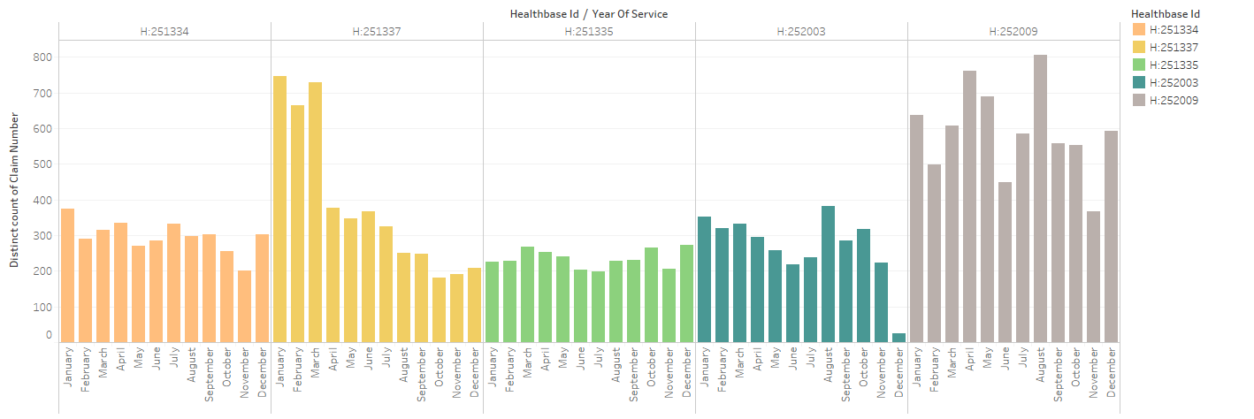
DATA CHALLENGES - 3
Volume variability/volatility – Even with facilities that pass the continues coverage rules, irregular data capture (or high volume variability/volatility) is sometimes observed.
Notes:
Need Omnya’s input here

Slide 10
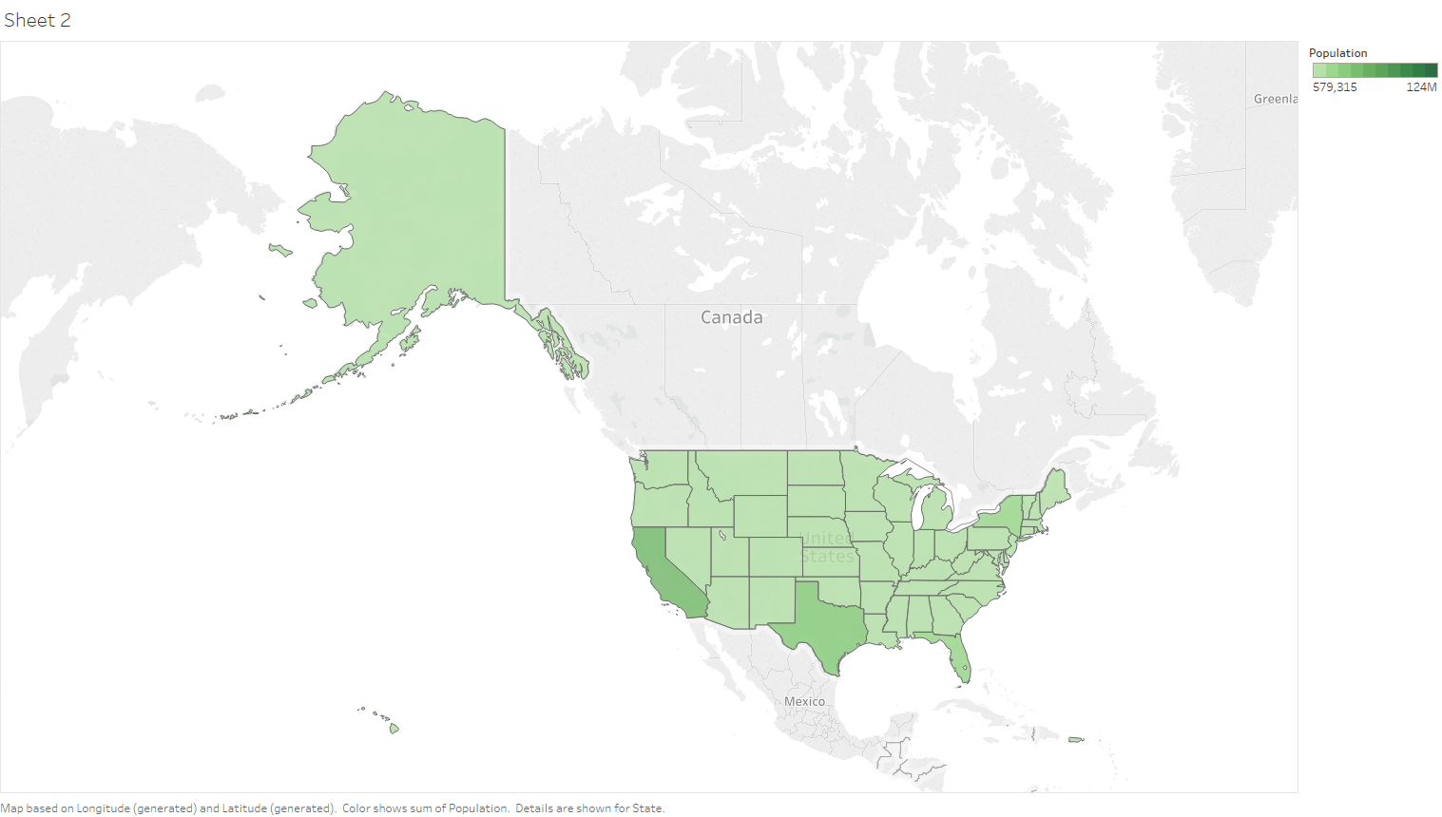
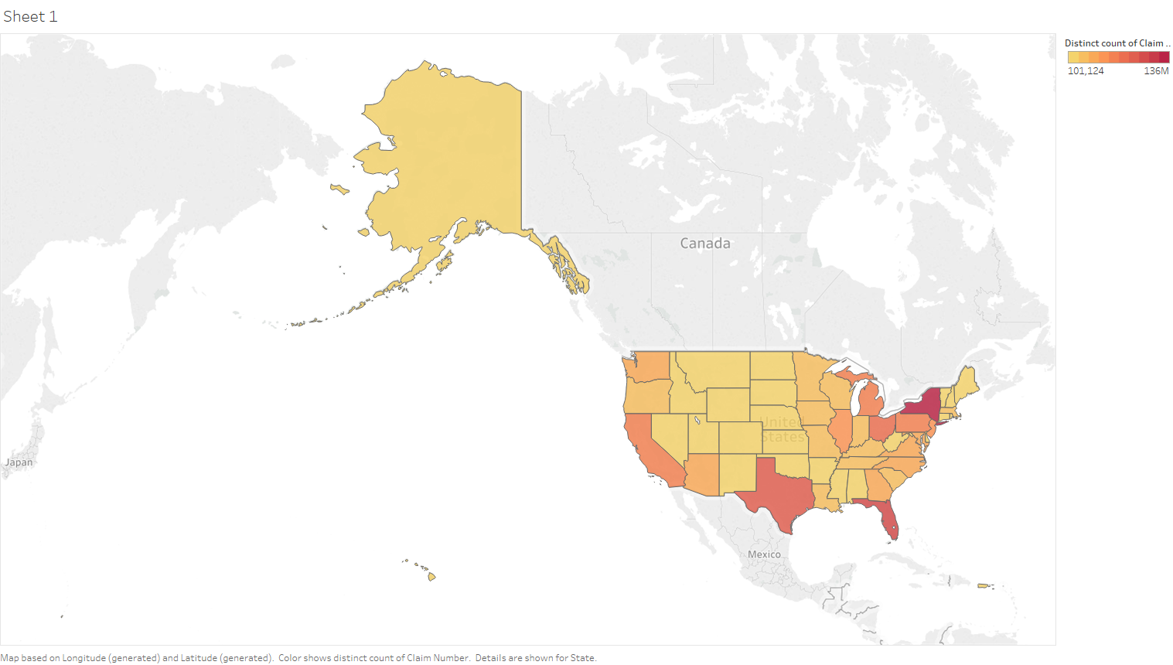
DATA CHALLENGES - 4
Region Bias – low coverage in CA and TX!
US Census (2017)
DRG RWD (2017)
Source: https://www.census.gov/programs-surveys/acs/
Notes:
Need Omnya’s input here

Slide 11
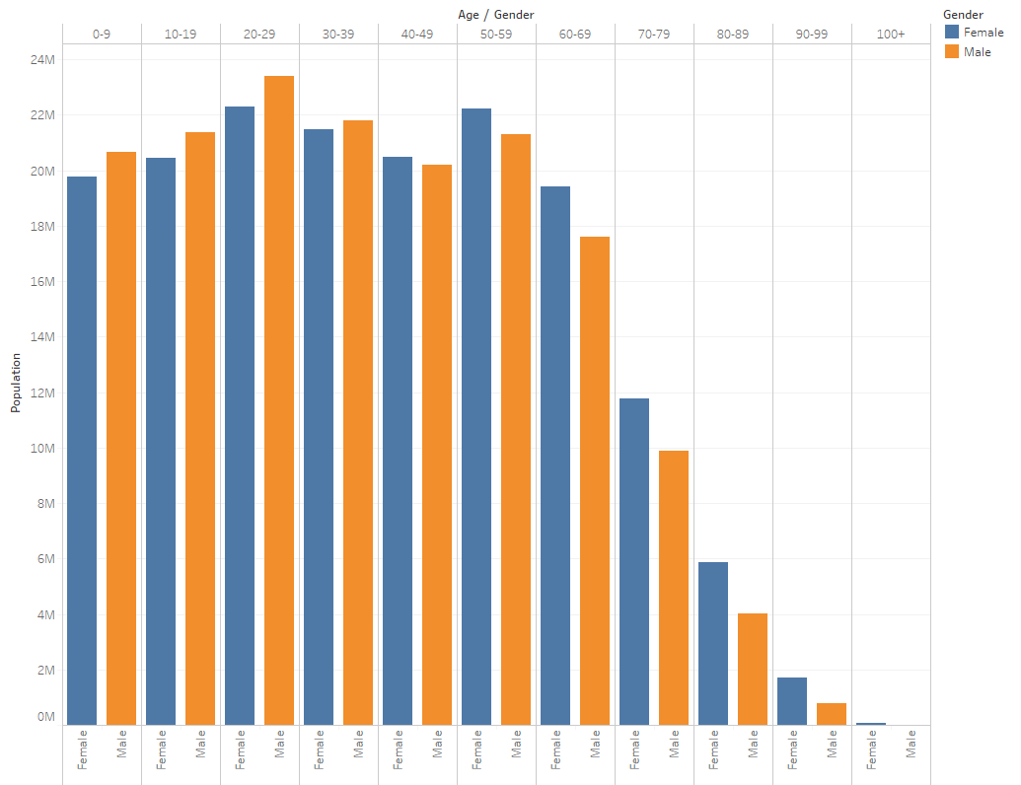
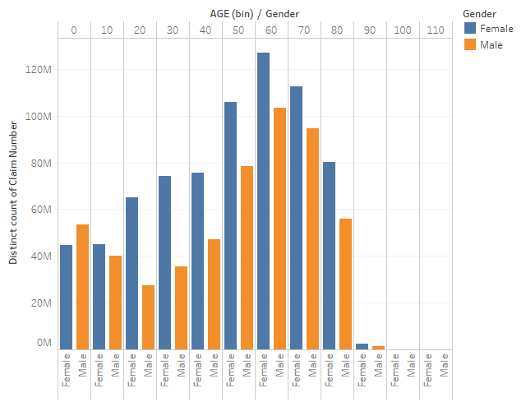
DATA CHALLENGES - 5
Age Bias - What is going on here!
US Census (2017)
DRG RWD (2017)
Source: https://www.census.gov/programs-surveys/acs/
Notes:
Need Omnya’s input here

Slide 12
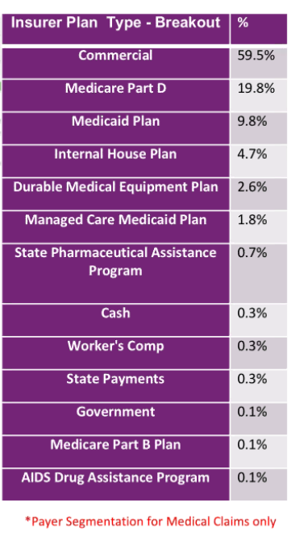
DATA CHALLENGES - 6
Insurance Type Bias – Why I rant about this! And why you should all do ..
US Insured Lives
(2017)
Insurance Type | %
Commercial | 49%
Non-Group | 7%
Medicaid | 19%
Medicare | 14%
Other Public | 2%
Uninsured | 9%
Total | 100%
DRG RWD
Source: https://www.kff.org/other/state-indicator/total-population/?currentTimeframe=0&sortModel=%7B%22colId%22:%22Location%22,%22sort%22:%22asc%22%7D
Notes:
Need Omnya’s input here

Slide 13
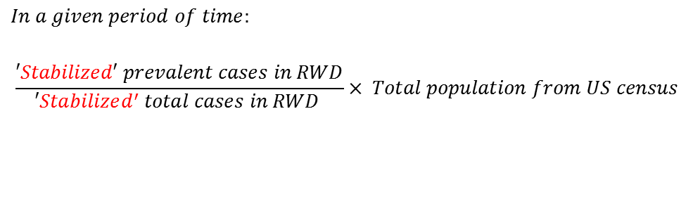
Business rules applied to overcome these challenges
$$In a given period of time:$$
$$\frac{′Stabilized′ prevalent cases in RWD}{′Stabilized^{′} total cases in RWD }× Total population from US census$$
Use the latest ‘stable’ year of data
Build a ‘stabilized’ panel to include only facilities with continuous coverage and low volume variability/volatility
Stratified Sampling
Notes:
Add incidence
Type of projects/ use cases/business questions

Slide 14
CASE STUDY: What is the prevalence of Schizophrenia in the US in 2017?

Slide 15
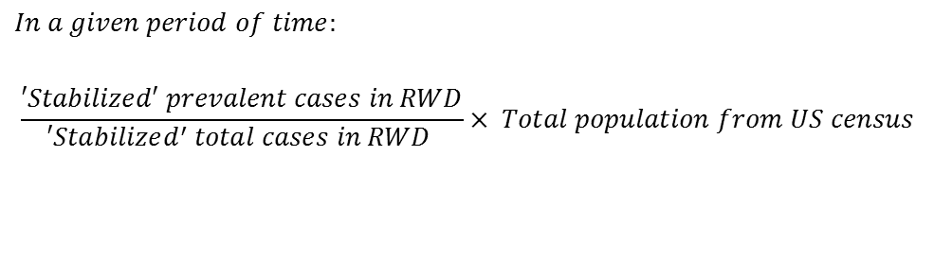
CALCULATION steps
1
Prepare Non-stabilized Denominator Table
2
Prepare Non-stabilized Numerator Table
3A
Prepare Stabilized Denominator Table
3B
Prepare Stabilized Numerator Table
4
Calculate Prevalence Rate for Each Strata
Stabilized Prevalence Rate
5
Apply US Census Data to Calculate National Prevalence
$$In a given period of time:$$
$$\frac{′Stabilized′ prevalent cases in RWD}{′Stabilized^{′} total cases in RWD }× Total population from US census$$
6
QC the Results

Slide 16
STEP 1: Prepare Non-stabilized Denominator Table
Stabilized Prevalence Rate
$$In a given period of time:$$
$$\frac{′Stabilized′ prevalent cases in RWD}{′Stabilized^{′} total cases in RWD }× Total population from US census$$
STEP 1
WALK THROUGH OF THE STEP | QC
1. Grab all 2017 claims (regardless of Dx) | Check the number of claims and patients in 2017 -- 1,310,834,495 claims / 161,842,370 patients
2. Append facility label and healthbase_id to each claim* | How many claims have valid healthbase_id? -- 1,306,706,521 claims (99.69%)
3. Append patient age, gender, zip3 and state to each claim** | How many claims and patients do we have after the processing/cleaning? -- 1,279,570,417 claims (97.61%) / 160,559,978 patients (99.21%)
Notes:
* For facility label and healthbase_id:
For claims with a mastered organization_npi (from project_analytics.reference.CLAIMS_SUBMITS_FACILITY_MASTER_NEW), join with HEALTHBASE_ENTITYLOOKUP to get their healthbase_id
For claims without a mastered organization_npi (Osprey with the most cases), use their provider_npi and the associated healthbase_id as a surrogate. For claims with more than one provider_npi, decide the primary provider_npi for each.
** For patient information:
Make sure Use RWD_DB.THIRD_PARTY.ZIP3STATEMAP to exclude claims with invalid zip3/state pair

Slide 17
STEP 2: Prepare Non-stabilized Numerator Table
Stabilized Prevalence Rate
$$In a given period of time:$$
$$\frac{′Stabilized′ prevalent cases in RWD}{′Stabilized^{′} total cases in RWD }× Total population from US census$$
STEP 2
WALK THROUGH OF THE STEP | QC
1. Get a list of Schizophrenia diagnosis code (ICD9 & ICD10) | Confirm the list of code with internal TA experts, Google etc.
2. Join with the denominator table to get Schizophrenia claims in 2017 | How many claims and patients do we have? Does that make sense? -- 4,131,099 claims / 545,775 patients (~ 0.34% of total patients)

Slide 18
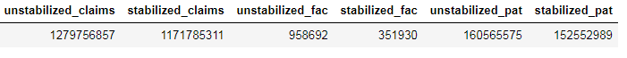
STEP 3A: Prepare Stabilized Denominator Table
Stabilized Prevalence Rate
$$In a given period of time:$$
$$\frac{′Stabilized′ prevalent cases in RWD}{′Stabilized^{′} total cases in RWD }× Total population from US census$$
STEP 3A
WALK THROUGH OF THE STEP | QC
1. To ensure continuous coverage, subset the non-stabilized denominator table to include only facilities with >10 months of data in the year were excluded | How many facilities in the non-stabilized vs stabilized panel? -- Total # of facilities: 965,715 / # of facilities left: 454,103 (47.02%)
2. To ensure low volume variability/volatility, calculate the CV of claims by month for each facility and exclude facilities with high variability. In this example, only facilities with CV < 0.6 were kept. | How many facilities left in the stabilized panel? Compare the # of claims/patients/facilities in the stabilized vs non-stabilized denominator.

Slide 19
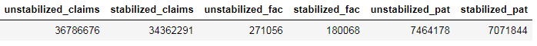
STEP 3B: Prepare Stabilized Numerator Table
Stabilized Prevalence Rate
$$In a given period of time:$$
$$\frac{′Stabilized′ prevalent cases in RWD}{′Stabilized^{′} total cases in RWD }× Total population from US census$$
STEP 3B
WALK THROUGH OF THE STEP | QC
1. From the non-stabilized numerator table, subset and include only facilities appeared in the stabilized denominator table | Compare the # of claims/patients/facilities in the stabilized vs non-stabilized numerator.

Slide 20
STEP 4: Calculate Prevalence Rate for Each Strata
Stabilized Prevalence Rate
$$In a given period of time:$$
$$\frac{′Stabilized′ prevalent cases in RWD}{′Stabilized^{′} total cases in RWD }× Total population from US census$$
STEP 4
WALK THROUGH OF THE STEP | QC
Decide what strata to use for the calculation of prevalence rate. Strata used in this case: Age Group: 0 – 19 / 20 – 44 / 45 – 64 / 65+ Gender: Male / Female Region (Two Levels): zip3 and state | Check key demographics for the disease such as age, gender, region etc.
Calculate the prevalence rate for each strata (for both stabilized and non-stabilized sets) | Plot the prevalence rate and see if there’s any outlier/crazy numbers. Any strata with NULL prevalence rate?

Slide 21
STEP 5: Apply US Census Data to Calculate National Prevalence
Stabilized Prevalence Rate
$$In a given period of time:$$
$$\frac{′Stabilized′ prevalent cases in RWD}{′Stabilized^{′} total cases in RWD }× Total population from US census$$
STEP 5
WALK THROUGH OF THE STEP | QC
Apply the prevalence rate to US census table for each strata (for both stabilized and non-stabilized sets) to calculate the number of prevalent cases in each strata | Check if there’s any strata with weird number
Aggerate the total number of prevalent cases in the US
Calculate national prevalence rate | See next slide

Slide 22
STEP 6: QC the Results - 1
QC: Check the difference between national stabilized vs non-stabilized results
QC: Compare the results to internal and external sources, are they aligned?
NATIONAL SCHIZOPHRENIA PREVALENCE Extrapolation EXERCISE (2017)
2017 Census Insured Lives Used in the Projection |  |  | 297,640,600 |  | Insured Population (Any Health Plan) in the US in 2017
Prevalent Cases | Extrapolated (Non-stabilized) |  | 1,185,232
 | Extrapolated (Stabilized) |  | 1,179,821
 | Internal Source (Diagnosed drug-treated prevalent cases in the US in 2017) | Source: DRG Insights | 1,390,000 |  | Source: United States Census Bureau**
 | External Source (Prevalence rate range between 0.25% and 0.64%) | Source: NIMH* | 812,500 - 2,080,000 |  | 2,946,130,000
Prevalence Rate | National Aggregated (Non-stabilized) |  | 0.40%
 | National Aggregated (Stabilized) |  | 0.40%
*National Institute of Mental Health: https://www.nimh.nih.gov/health/statistics/schizophrenia.shtml
**United States Census Bureau: https://www.census.gov/content/dam/Census/library/publications/2018/demo/p60-264.pdf

Slide 23
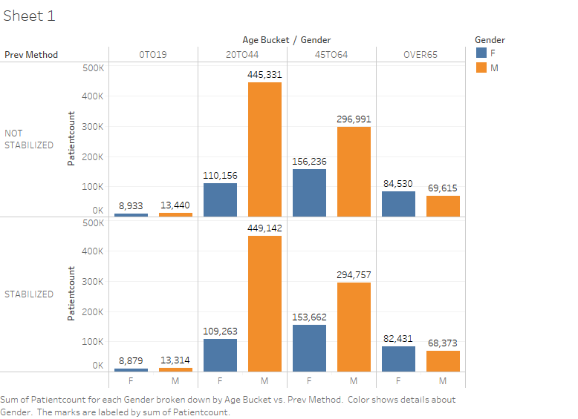
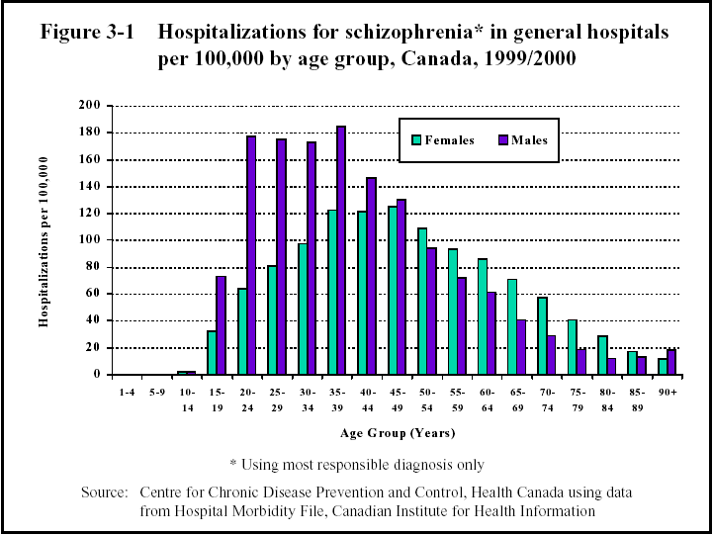
STEP 6: QC the Results - 2
QC: Check stabilized vs non-stabilized prevalence at strata level (age/gender)
Extrapolated Prevalence by Age/Gender
Hospital Data from Canada (1999/2000)
Source: http://www.schizophrenia.com/szfacts.htm#

Slide 24
STEP 6: QC the Results - 3
QC: Check stabilized vs non-stabilized prevalence at strata level (state)
Extrapolated Prevalence by State
STATE | PREVALENCE (NON STABILIZED) | PREVALENCE (STABILIZED) | DELTA (%) |  | STATE | PREVALENCE (NON STABILIZED) | PREVALENCE (STABILIZED) | DELTA (%) |  | STATE | PREVALENCE (NON STABILIZED) | PREVALENCE (STABILIZED) | DELTA (%)
AK | 1463 | 1489 | 2% |  | KY | 13606 | 13219 | -3% |  | NY | 93852 | 93170 | -1%
AL | 17033 | 17120 | 1% |  | LA | 23928 | 23933 | 0% |  | OH | 41763 | 41037 | -2%
AR | 8866 | 8475 | -4% |  | MA | 27766 | 27223 | -2% |  | OK | 7653 | 7065 | -8%
AZ | 27586 | 27815 | 1% |  | MD | 17899 | 17299 | -3% |  | OR | 12602 | 12262 | -3%
CA | 242176 | 244171 | 1% |  | ME | 3904 | 3882 | -1% |  | PA | 49878 | 49352 | -1%
CO | 14392 | 14624 | 2% |  | MI | 32510 | 32058 | -1% |  | RI | 2370 | 2309 | -3%
CT | 13956 | 13767 | -1% |  | MN | 26558 | 26815 | 1% |  | SC | 13292 | 13317 | 0%
DC | 3186 | 2919 | -8% |  | MO | 17707 | 17814 | 1% |  | SD | 1724 | 1122 | -35%
DE | 3237 | 3173 | -2% |  | MS | 8579 | 8505 | -1% |  | TN | 20566 | 20123 | -2%
FL | 77329 | 75832 | -2% |  | MT | 3053 | 3106 | 2% |  | TX | 75900 | 75583 | 0%
GA | 33986 | 34337 | 1% |  | NC | 28506 | 28631 | 0% |  | UT | 4759 | 4402 | -7%
HI | 6716 | 6428 | -4% |  | ND | 1801 | 1833 | 2% |  | VA | 23667 | 23469 | -1%
IA | 13967 | 13702 | -2% |  | NE | 3589 | 3537 | -1% |  | VT | 1309 | 1325 | 1%
ID | 4168 | 4083 | -2% |  | NH | 2610 | 2614 | 0% |  | WA | 24092 | 25741 | 7%
IL | 49670 | 49982 | 1% |  | NJ | 18699 | 18322 | -2% |  | WI | 14215 | 14231 | 0%
IN | 20875 | 20486 | -2% |  | NM | 9300 | 9268 | 0% |  | WV | 3989 | 3905 | -2%
KS | 5973 | 6067 | 2% |  | NV | 8360 | 8228 | -2% |  | WY | 651 | 649 | 0%

Slide 25
EXERCISE TIME!
Question to answer
What is the prevalence rate of the following diseases in the US in 2017?
Chronic Obstructive Pulmonary Disease (COPD)
Crohn’s Disease (CD)
Tables to use
Non-stabilized Denominator Table
sandbox_analytics.sandbox. PREVALENCE_EXCERCISE_PREVALENCE_DENOMINATOR_FINAL
COPD and CD Diagnosis Code Table
sandbox.PREVALENCE_EXCERCISE_COPD_CD_Market_Def
US Census Insured Lives Table (# of insured lives)
To be provided

Slide 26
EXERCISE TIME!
Deliverables & evaluation
The following deliverables are expected by the next training session:
An analytics plan that includes the disease background, epidemiology stats, analysis plan and business rules applied etc.
A jupyter notebook with the codes
A short presentation that walks through the results, key QC steps and logics etc.
During the exercise, each team member would be evaluated based on the following three criteria:
How they interact with each other
How well they understand the material
How creative/innovative they are during the exercise
Teams & Instructors
Maddy | Ru Yun | Tony
Team 1 | Team 2 | Team 3
Suan Chin | Wing | Adi
Priyanka | Vikas | Pulkit
Team 4 | Team 5 | Team 6
Chitra | Geetanjan | Sandeep
Zishan | Renish | Chinmay
Team 7 | Team 8 | Team 9
Manoj | Sanket | Emeka
Jawaad | Sachin | Ankit
Poushali

